Slide 1








SISTEM KENDALI JEMURAN ANTISIPASI HUJAN
Final Project by
Ahmad Lufi Alfianul ‘Ula
Muhammad Faizul Fikri Ilmansyah
Notes:
Assalamualakum Wr. Wb.
Good morning Mr/Mrs …
Thank you for coming to our final project presentation
My name is Ahmad Lufi Alfianul Ula, for this final project I’m worked on the API and Interface side of this system. And this is my friend
My name is Muhammad Faizul Fikri Ilmansyah, for this final project I’m worked on the hardware
Our topic for this final project presentation is “The Rain Anticipation Clothesline Control System”.
So without further do, let’s get started

Slide 2
PROBLEM BACKGROUND
Laundry services are very dependent on weather conditions that are unpredictable every day. When it rains clothes drying in the sun, it must be immediately put into the house so as not to get wet. When the clothes are dried in the sun again, it takes time to dry them again.

Slide 3
RESEARCH GAP
Alat Pengendali Atap Jemuran Otomatis Dengan Sensor Cahaya Dan Sensor Air Berbasiskan Mikrokontroler ATmega16
(Mufida dan Abas, 2017)
Internet of things is not implemented on those research.
Rancang Bangun Sistem Jemuran Otomatis dengan Kendali Raspberry PI
(Faisal, Aliyadi dan Angga, 2018)
Rancang Bangun Sistem Jemuran Otomatis Berbasis Arduino Uno
(Yuwono dan Alam, 2018)
Desain System Smart Clothesline Berbasis Arduino Dengan Metode Logika Fuzzy
(Candra dan Very, 2018)

Slide 4
AIMS
Design and build a Rain Anticipation Clothesline Control System integrated with an Android-based smartphone that is used to anticipate rain when it rains.
Notes:
Our aims for building this system is

Slide 5
THE BENEFITS
Help laundry owners in monitoring clothesline conditions.
Help laundry owners to speed up the process of drying clothes.
Help laundry owners in protecting clothes line when it rains.
Notes:
Our benefits for building this system is

Slide 6
METHOD
2. Design
3. Coding
1. Requirement analysis
4. Testing
Notes:
We’re using waterfall method to build this system. Waterfall method that we used have 4 phase,
first, requirement analysis, in this phase we collecting the data that will be used to build this system, like hardware and software requirement needs
Design, in this phase we define the system design that will be explained after this, and also hardware design that will be explained at hardware demo
Implementation, in this phase we start to code the program, convert the design and implement it to hardware.
Testing, this is the last phase of waterfall method, in this phase we test all sensors, and we test the application to users.

Slide 7
DESIGN SYSTEM

Slide 8
APPLICATION FEATURES

Slide 9
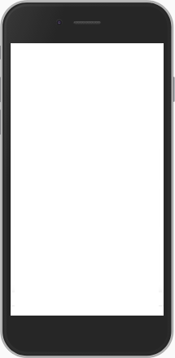
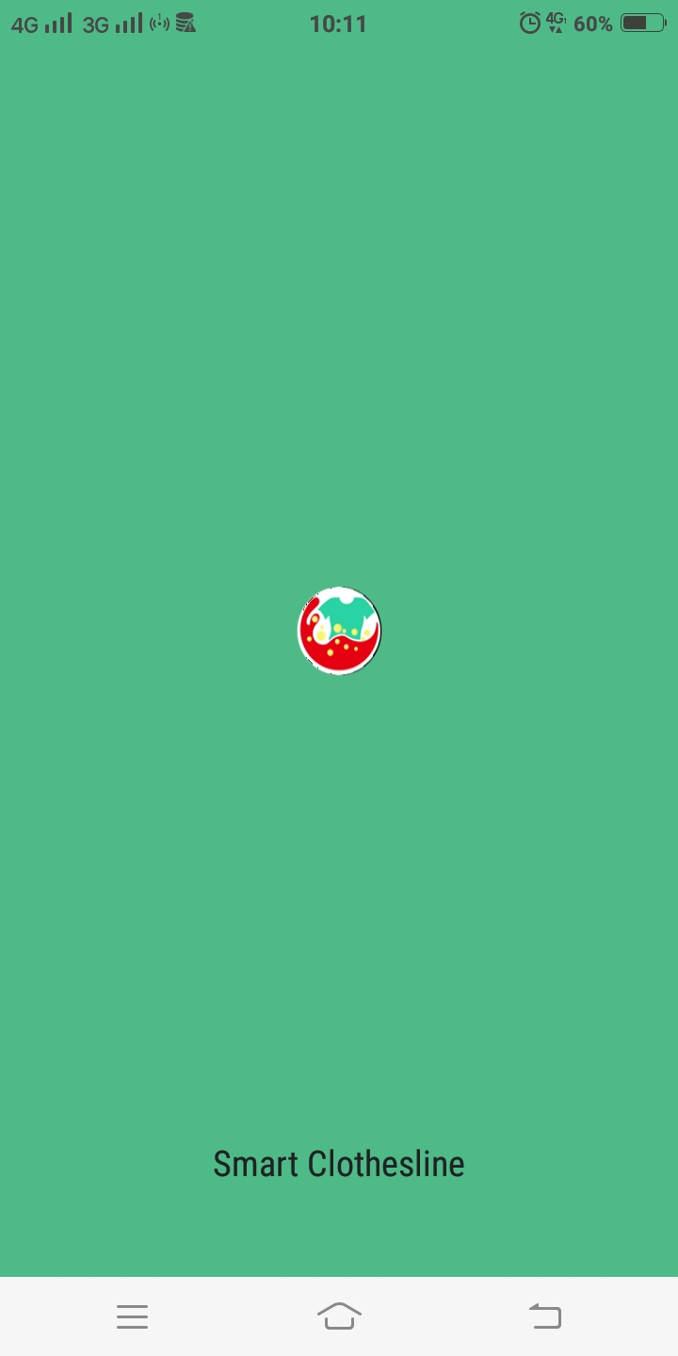
SPLASH SCREEN
First page of this application. This page show logo of the App

Slide 10
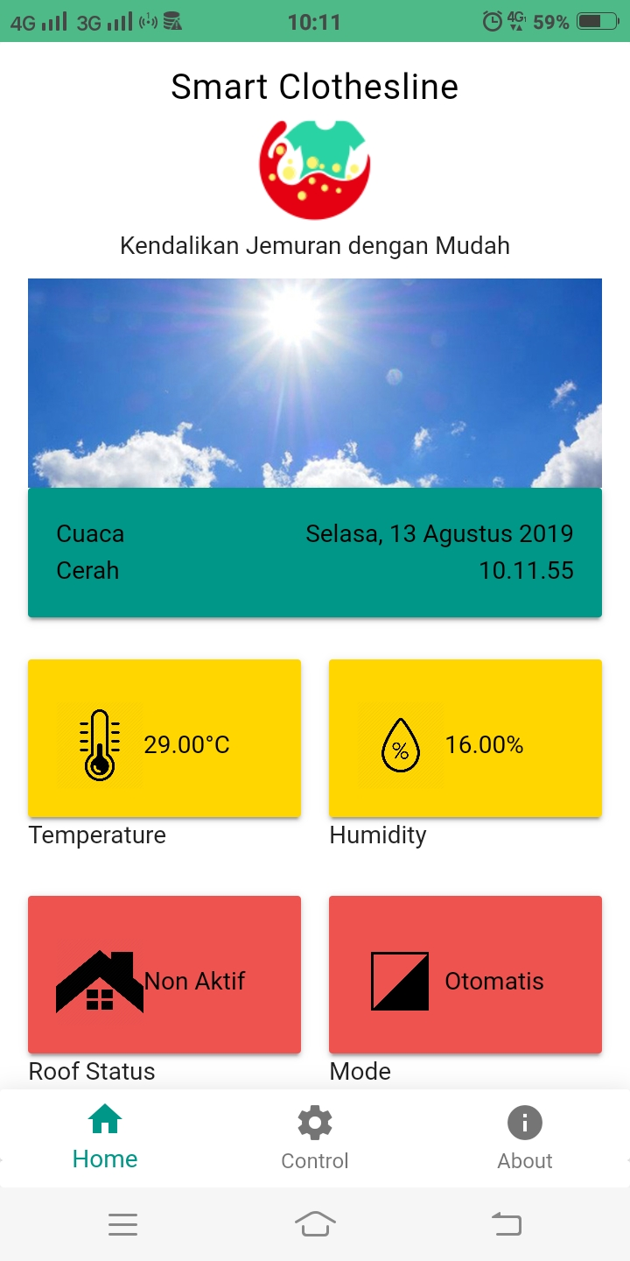
HOME PAGE
This page display the data that taken from the database in form of timestamp and reading results as well as the condition of the system

Slide 11
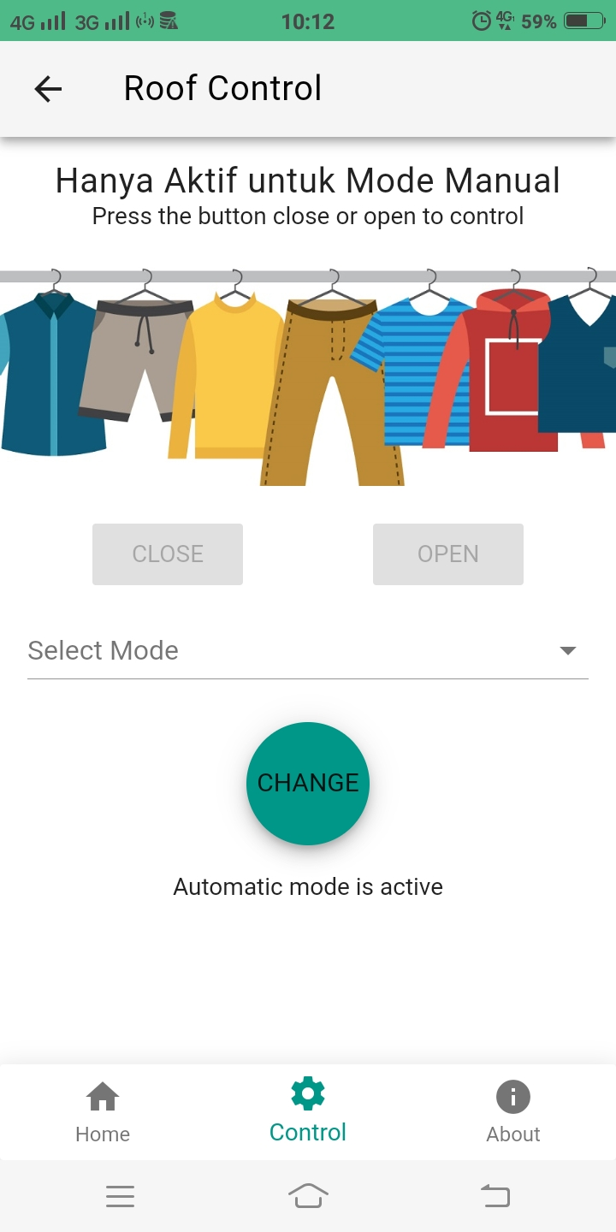
CONTROL PAGE (AUTOMATIC MODE)
This page display automatic mode. Open and close buttons are disable.

Slide 12
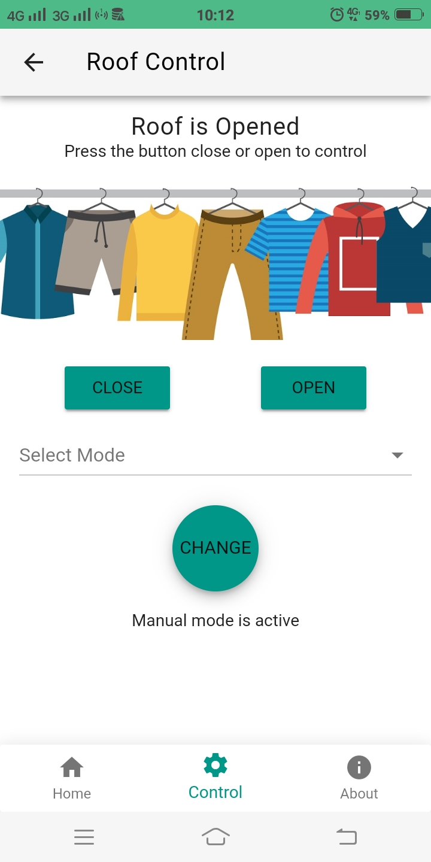
CONTROL PAGE (MANUAL MODE)
This page display manual mode. Open and close buttons are enable.

Slide 13
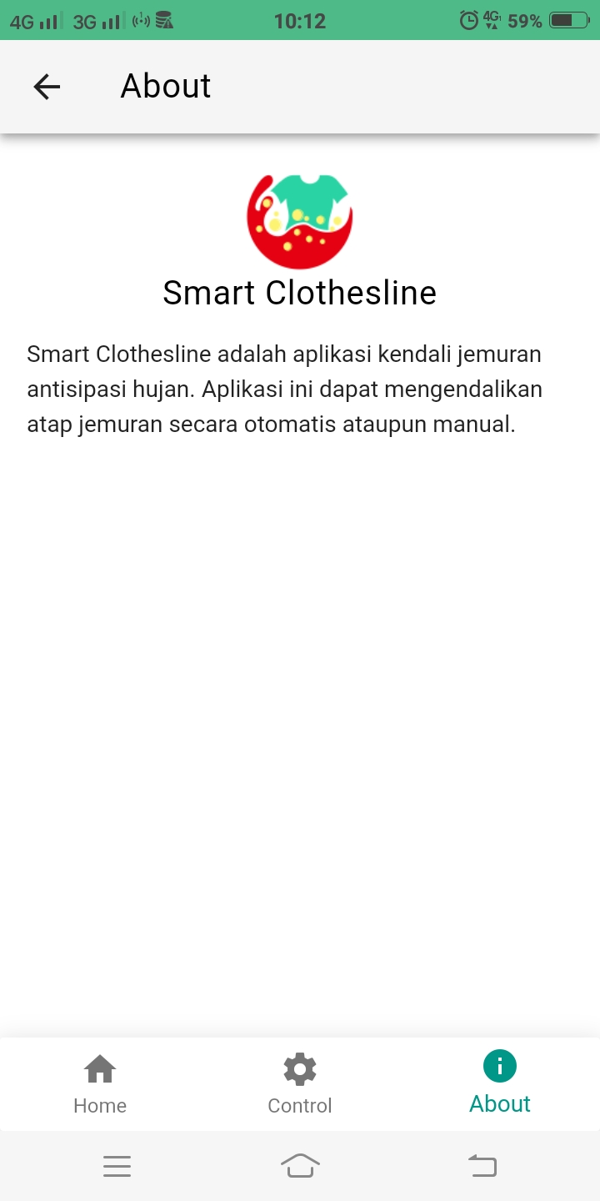
ABOUT PAGE
This page display about smart clothesline app.

Slide 14
TESTING
Rain Sensor FC-37
No. | Number of Drops | Roof Conditions
1 | 3 drop | Close
2 | 6 drop | Close
3 | 9 drop | Close
4 | 12 drop | Close
5 | 15 drop | Close
6 | 18 drop | Close
7 | 21 drop | Close
8 | 24 drop | Close
9 | 27 drop | Close
10 | 30 drop | Close

Slide 15
TESTING
LDR Sensor
No. | Time | LDR Sensor Intensity (Lux) | Roof Conditions
1 | 08.00 am | 521 | Open
2 | 08.05 am | 524 | Open
3 | 08.10 am | 520 | Open
4 | 08.15 am | 521 | Open
5 | 01.00 pm | 703 | Open
6 | 01.05 pm | 703 | Open
7 | 01.10 pm | 703 | Open
8 | 01.15 pm | 704 | Open
9 | 05.00 pm | 470 | Close
10 | 05.05 pm | 455 | Close
11 | 05.10 pm | 443 | Close
12 | 05.15 pm | 431 | Close

Slide 16
TESTING
DHT11 Sensor
No. | Time | Temperature (Celcius) | Roof Conditions
1 | 08.00 am | 26 | Open
2 | 08.05 am | 26 | Open
3 | 08.10 am | 26 | Open
4 | 08.15 am | 26 | Open
5 | 01.00 pm | 29 | Open
6 | 01.05 pm | 29 | Open
7 | 01.10 pm | 29 | Open
8 | 01.15 pm | 29 | Open
9 | 05.00 pm | 27 | Close
10 | 05.05 pm | 27 | Close
11 | 05.10 pm | 27 | Close
12 | 05.15 pm | 26 | Close

Slide 17
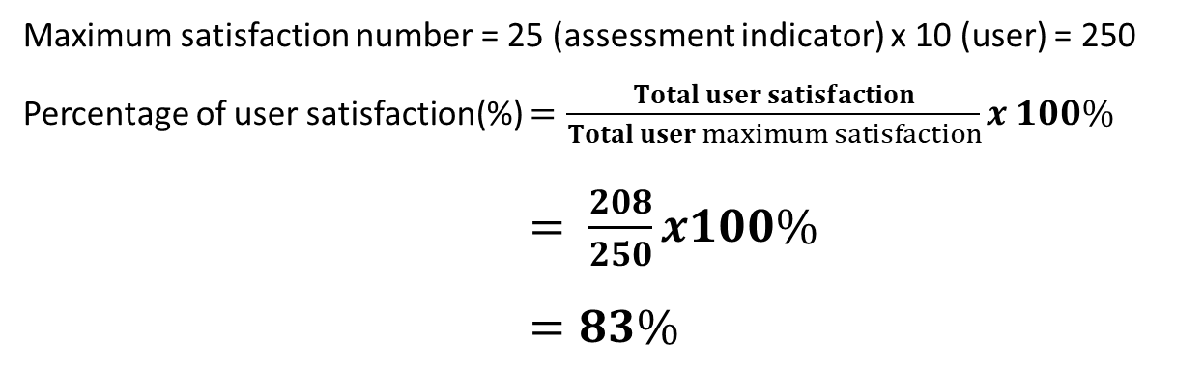
RESULT
Questionnaire Results
The satisfaction level of 10 respondents is 83% which means they are very satisfied with our system
Maximum satisfaction number = 25 (assessment indicator) x 10 (user) = 250
Percentage of user satisfaction(%) $=\frac{Total user satisfaction}{Total user maximum satisfaction}x 100\%$
$= \frac{208}{250}x100\%$ $=83\%$
Testing of Functionalities
All functionalities of this system can work properly

Slide 18
CONCLUSION
The Rain Anticipation Clothesline Control System can work in two modes, manual and automatic.
The results of testing the level of user satisfaction in the Rain Anticipation Clothesline Control System shows an 83% (very satisfying) number of 10 laundry spread in the Tembalang area.

Slide 19
HARDWARE DEMONSTRATION
Notes:
For this demo, in this system we’re using Power Bank that have maximum voltage on 5 volt to power this motor servo.
On this system, there are rain sensor, dht11 sensor and ldr sensor to drive the servo motor. The rain sensor, dht11 sensor and ldr sensor is connected to NodeMCU that we mounted back this board. This system also have android app to show the result
So, let us start this system.
Page Monitor
The value this application get from database will shown here, in this page, and will be updated everytime nodemcu get new data. This page also show the description for condition rain sensor,
if it rains, it shows a picture of rainy weather.
if it does not rain, it shows a picture of sunny weather.
Page Control
System there are two mode, manual and automatic
Page About
This page show information app

Slide 20
Thanks

